Slide 1
Network traffic state estimation using Hamilton Jacobi equations
Christian Claudel
Assistant professor, Civil, Architectural and Environmental Engineering
University of Texas, Austin

Slide 2
Outline
Estimation problems involving Hamilton-Jacobi equations
- Background
- Problem definition
- Optimization formulations
Application to Networks
- Demand and supply formulation
- Junction models
- MILP formulation
Conclusion

Slide 3
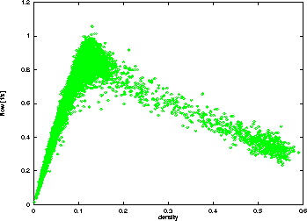
The LWR PDE
- First derived by Lighthill-Whitham (1955), and extended by Richards (1956)
- First order scalar hyperbolic conservation law
- Based on the conservation of vehicles, and on the existence of a relationship between flow and density: q=ψ(ρ).
ψ(.) is assumed to be concave
2000
Flow ψ(ρ) (veh/h)
1000
0
50
100
Source: PeMS
Density ρ (veh/mile)
[Newell 93], [Daganzo 03,06]

Slide 4
Integral formulation
Equivalently, we can define M(t,x) such that:
The function M(t,x) is called Moskowitz function. Its spatial derivative is the opposite of the density function; its temporal derivative is the flow function.
M(t,x) satisfies the following Hamilton-Jacobi PDE:
[Newell 93], [Daganzo 03,06]

Slide 5
Physical interpretation of the Moskowitz function
M(t,x) can be interpreted as a vehicle label at location x and time t (assuming that no vehicles pass each other).
M(t,x) is also known as the cumulative vehicle number in the traffic flow community.
1
6
2
5
4
3
3
2
1
4
vehicle label
position
5
6
[Newell 93], [Daganzo 03,06]

Slide 6
Semi-analytic computational methods
Existing computational methods:
For LWR:
Godunov scheme (or equivalently CTM)
Wave-front tracking
Other finite difference schemes (ENO, WENO)
For HJ:
Lax Friedrichs schemes (or other numerical schemes)
Variational method (dynamic programming)
Semi-analytic method (for homogeneous problems), which can be used for both HJ and LWR
[Daganzo06] [Claudel Bayen IEEE TAC part I & 2, 2010] [Mazare Dehwah Claudel Bayen, TR-B 2012]

Slide 7
Semi-analytic computational methods
Based on the classical Lax-Hopf formula
For a boundary data function c(.,.), the solution M_{c}(.,.) is given by:
where is the convex transform of ψ
Position
c(.,.)
Time
[Lax 1973] [Aubin Bayen Saint Pierre SIAM SICON 2009] [Claudel Bayen IEEE TAC part II 2010]

Slide 8
Semi-analytic computational methods
Inf-morphism property
Let us assume that the boundary data c is the minimum of a finite number of lower semicontinuous functions:
The solution associated with the above boundary data function can be decomposed as:
Position
c₈(.,.)
c₉(.,.)
c₃(.,.)
c₂(.,.)
c₇(.,.)
c₁₁(.,.)
c₁₂(.,.)
c₁(.,.)
c₁₀(.,.)
Time
c₄(.,.)
c₅(.,.)
c₆(.,.)
[Claudel Bayen IEEE TAC part II 2010] [Mazare Dehwah Claudel Bayen, TR-B 2012]

Slide 9
Semi-analytic computational methods
Inf-morphism property
Let us assume that the boundary data c is the minimum of a finite number of lower semicontinuous functions:
The solution associated with the above boundary data function can be decomposed as:
Position
c₈(.,.)
c₃(.,.)
c₂(.,.)
c₁₀(.,.)
Time
c₄(.,.)
[Claudel Bayen IEEE TAC part II 2010] [Mazare Dehwah Claudel Bayen, TR-B 2012]

Slide 10
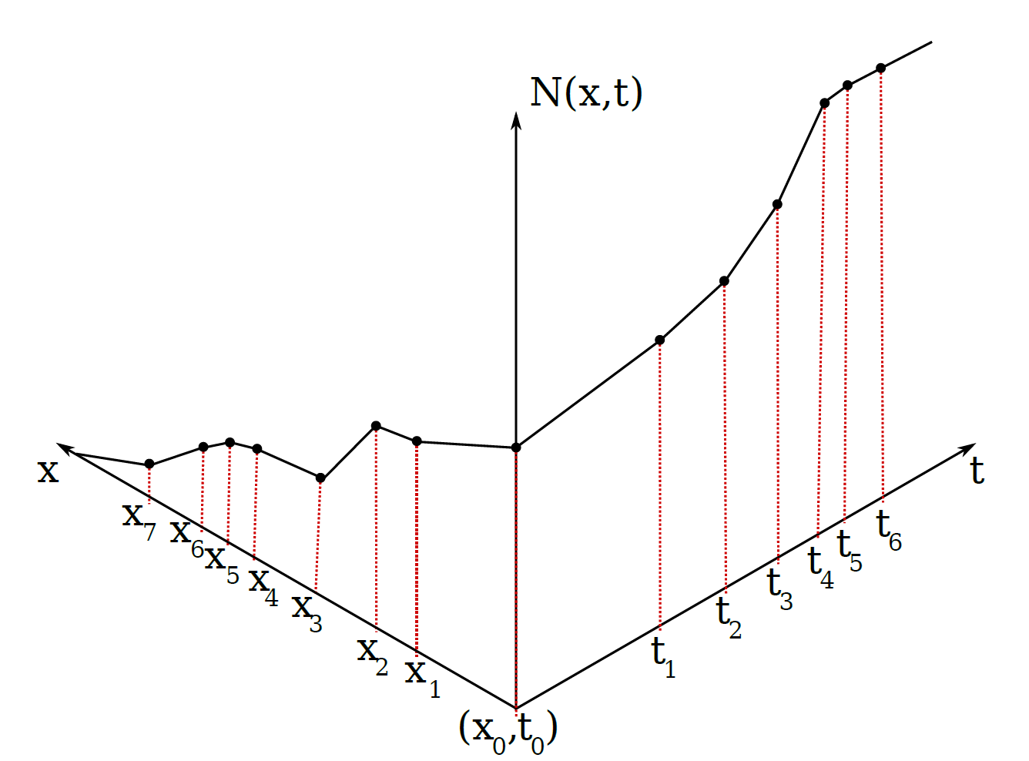
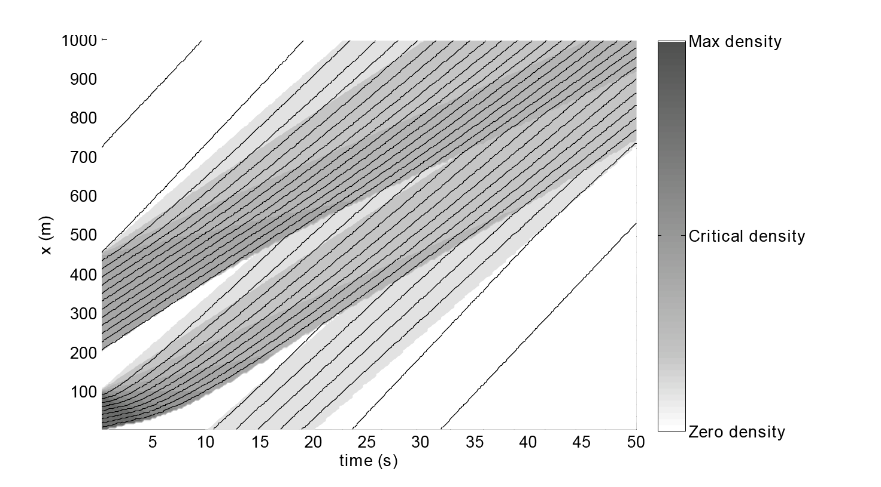
Semi-analytic computational methods
The solution associated with the above boundary data function can be decomposed as:
position
position
time
time
[Claudel Bayen IEEE TAC part II 2010] [Mazare Dehwah Claudel Bayen, TR-B 2012]

Slide 11
Semi-analytic computational methods
The solution associated with the above boundary data function can be decomposed as:
position
position
time
time
[Claudel Bayen IEEE TAC part II 2010] [Mazare Dehwah Claudel Bayen, TR-B 2012]

Slide 12
Semi-analytic computational methods
The solution associated with the above boundary data function can be decomposed as:
position
position
time
time
[Claudel Bayen IEEE TAC part II 2010] [Mazare Dehwah Claudel Bayen, TR-B 2012]

Slide 13
Semi-analytic computational methods
The solution associated with the above boundary data function can be decomposed as:
position
position
time
time
[Claudel Bayen IEEE TAC part II 2010] [Mazare Dehwah Claudel Bayen, TR-B 2012]

Slide 14
Solutions to affine value conditions
The question becomes: can we quickly compute the solution associated with an affine (linear) initial or boundary condition?
To be able to use the inf morphism property in general, we need each affine initial or boundary condition to be defined on a subset of $ℝ^{2}$
Non physical/mathematical problem
[Daganzo 2005 TR-B] [Daganzo 2006] [Claudel Bayen TAC 2010]

Slide 15
Solutions to affine value conditions
Affine initial condition:
Affine upstream boundary condition
Affine downstream boundary condition
[Claudel Bayen TAC 2010]

Slide 16
Solutions to affine value conditions
Example of solution: affine initial condition
Lax-Hopf formula:
Objective function: convex (in u):
constraints also convex (intersection of intervals) : 1-D convex optimization.
[Claudel Bayen TAC 2010]

Slide 17
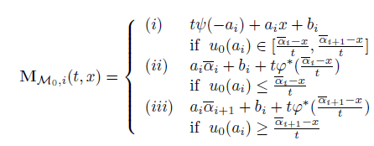
Solutions to affine value conditions
Explicit solution to the convex program requires the use of subgradients, since φ* is not necessarily differentiable.
Thus, posing as any element of , we have the following explicit solution:
[Claudel Bayen TAC 2010]

Slide 18
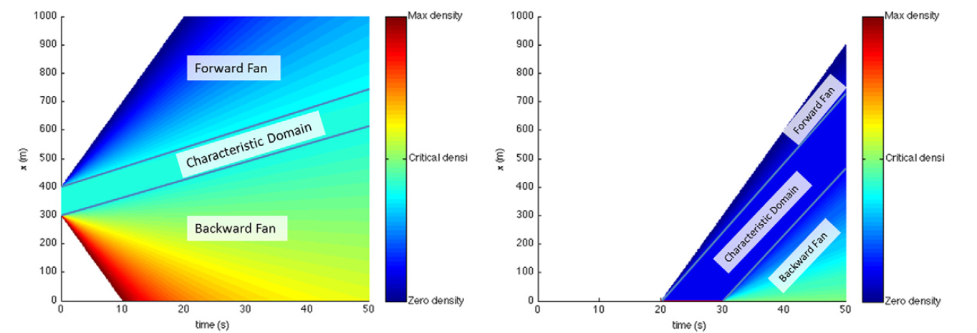
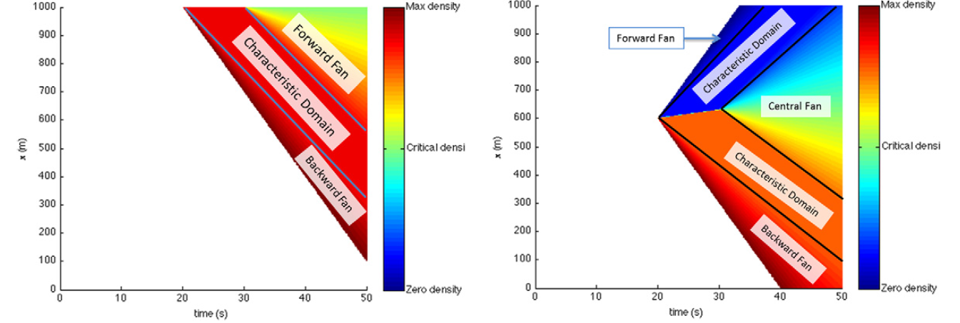
Solution structure
Solution structure:
[Claudel Bayen TAC 2010]

Slide 19
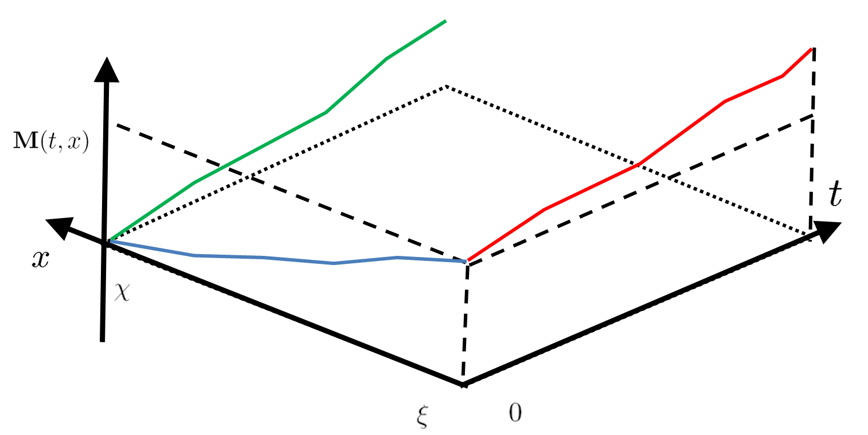
Data fusion problems
Solving the Hamilton Jacobi PDE requires the definition of initial and boundary conditions (Dirichlet problem)
Initial condition
Upstream boundary
condition
Downstream boundary
condition

Slide 20
Outline
Estimation problems involving Hamilton-Jacobi equations
- Background
- Problem definition
- Optimization formulations
Application to Networks
- Demand and supply formulation
- Junction models
- MILP formulation
Conclusion

Slide 21
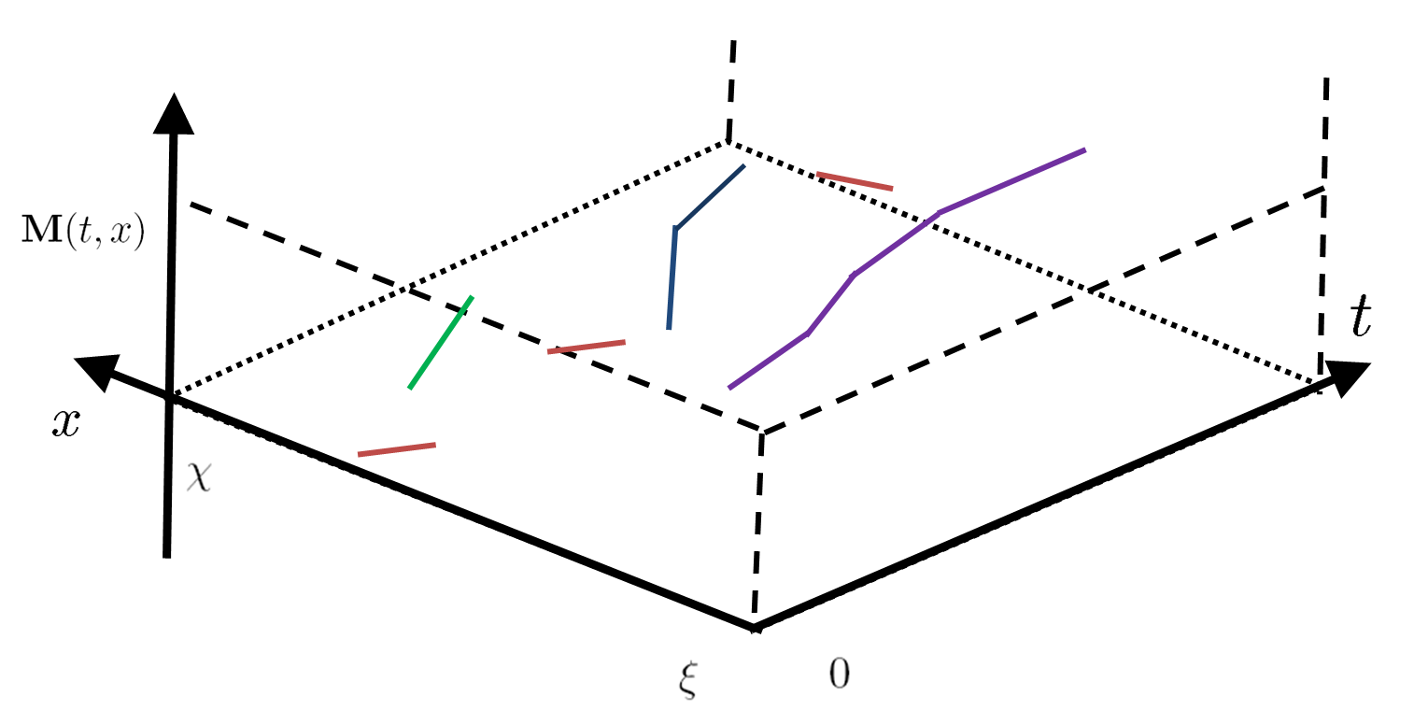
Data fusion problems
Solving the Hamilton Jacobi PDE requires the definition of initial and boundary conditions (Dirichlet problem)
In reality: this never happens
Density sensor (ex: loop detector, camera, radar)
Flow sensor (ex: loop detector, camera, radar)
Probe vehicle (ex: GPS equipped vehicle)
Probe vehicle (ex: GPS equipped vehicle)
Travel time data (ex: toll transponder)

Slide 22
Problem definition
The data generated by mobile phones and fixed detectors corresponds to a (partial) set of piecewise affine initial, boundary or internal conditions
The measurement data alone is not sufficient to express the PWA boundary conditions uniquely (because of sensor error, constants of integration, etc)
Loop detectors
position
Video or satellite
Aftermarket GPS receiver
Cellphone
time
[Claudel, Bayen, ACC 10 ], [Claudel, Bayen, SIAM SICON 10 (in review)]

Slide 23
Problem definition
Example:
position
Cellphone
time
[Claudel, Bayen, ACC 10 ], [Claudel, Bayen, SIAM SICON 10 (in review)]

Slide 24
Problem definition
Coordinates
Unknown coefficients
(constants of integration, or unmeasured quantities)
Approximately known from measurement data
[Claudel, Bayen, ACC 10 ], [Claudel, Bayen, SIAM SICON 10 (in review)]

Slide 25
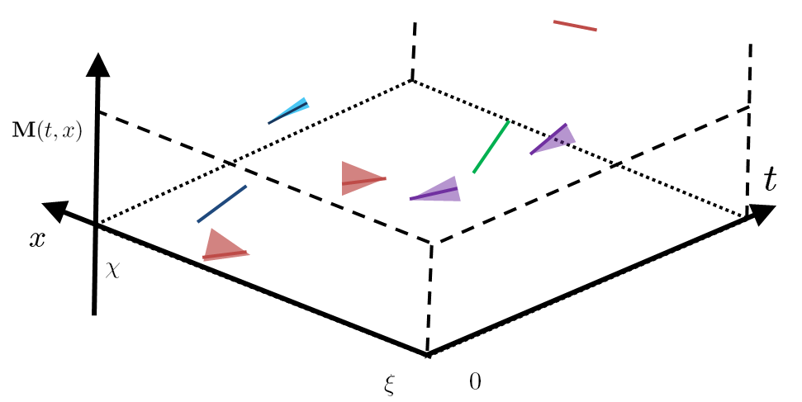
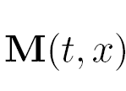
Data fusion problems
Sensors yield constraints on the solution:
Density sensors constrain the local density values
Flow sensors constrain the local flow values
Probe data constrain the local traffic velocity values
Travel time data constrain the cumulated flow curves (or vehicle labels)
Given an arbitrary dataset, how can one reconstruct the set of possible boundary data of the problem that are compatible with both the LWR model and the noisy measurement data?

Slide 26
Optimization formulation
Let us first describe all the unknowns of the initial, boundary and internal conditions generated by the sensors, and write these unknowns as a decision variable y
The decision variable y is constrained both by the measurement data and by the LWR model
Boundary condition (flow sensor): unknown offset, unknown flow
Internal condition (probe vehicle): unknown offset, unknown passing rate
Density condition (density sensor): unknown offset, unknown density
[Claudel Bayen SIAM 2012] [Canepa, Claudel IEEE ITSC 2012]

Slide 27
Constraints of measurement data
Data constraints: easy to encode, usually convex in y (in practice, linear or quadratic in y)
Example: suppose that we have upstream boundary flow sensors that measure the flow with 5% relative error, and that the density of the 3rd initial condition block is measured by a sensor with 10% absolute error:
[Canepa Claudel IEEE ITSC 2012]
Notes:
Moins de formules

Slide 28
Constraints of measurement data
Data constraints: easy to encode, usually convex in y (in practice, linear or quadratic in y)
Example: suppose that we have upstream boundary flow sensors that measure the flow with 5% relative error, and that the density of the 3rd initial condition block is measured by a sensor with 10% absolute error:
[Canepa Claudel IEEE ITSC 2012]
Notes:
Moins de formules

Slide 29
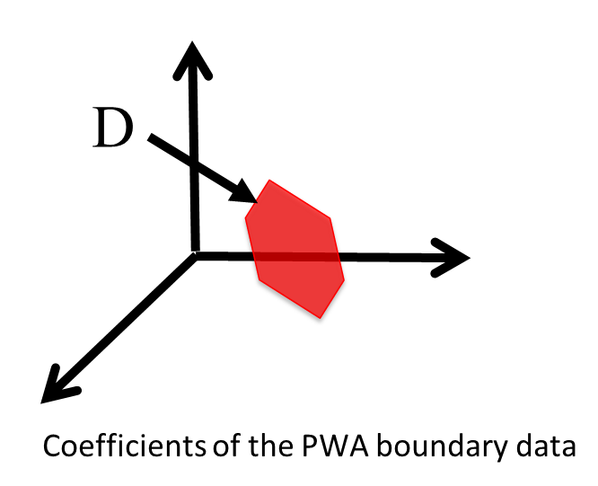
Constraints of measurement data
Data constraints: easy to encode, usually convex in y (in practice, linear or quadratic in y)
Example: suppose that we have upstream boundary flow sensors that measure the flow with 5% relative error, and that the density of the 3rd initial condition block is measured by a sensor with 10% absolute error:
However, PDE model constraints are much harder to encode, can even be not explicit
Linear constraints
[Canepa Claudel IEEE ITSC 2012]
Notes:
Moins de formules

Slide 30
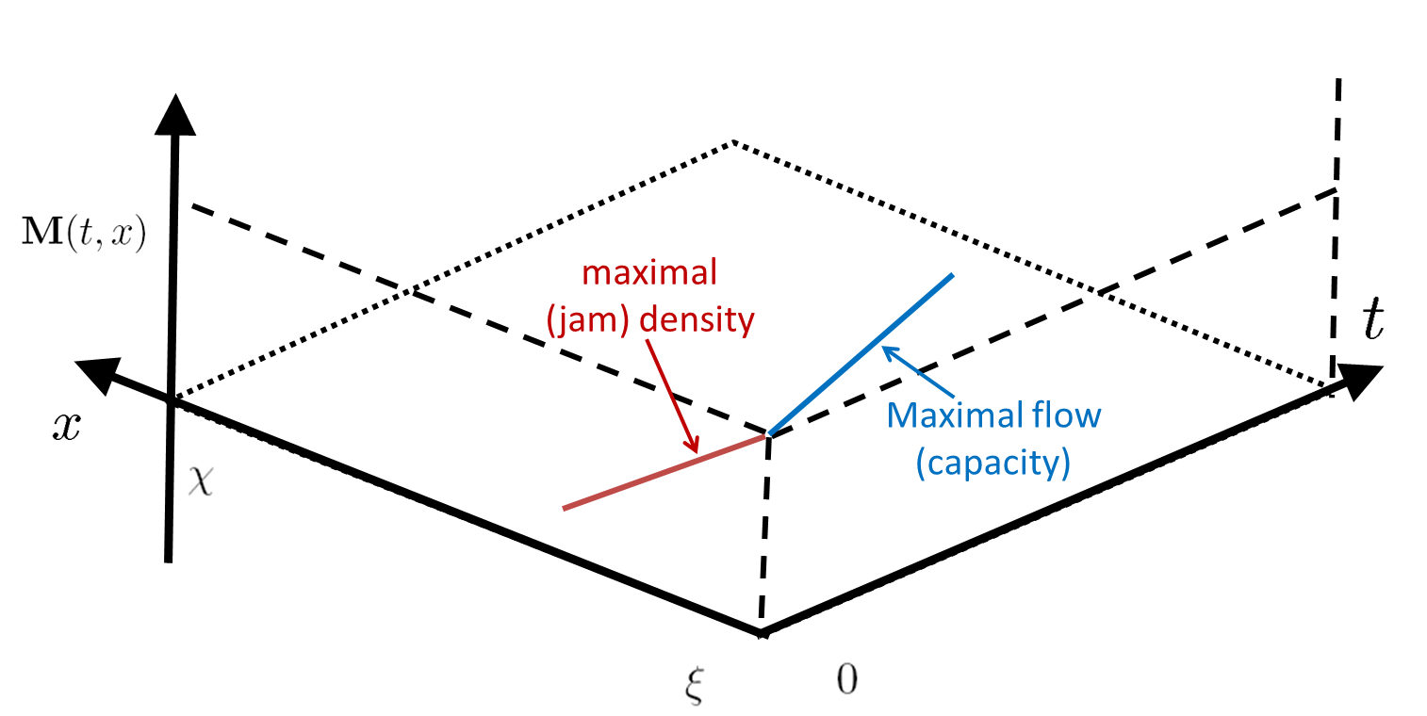
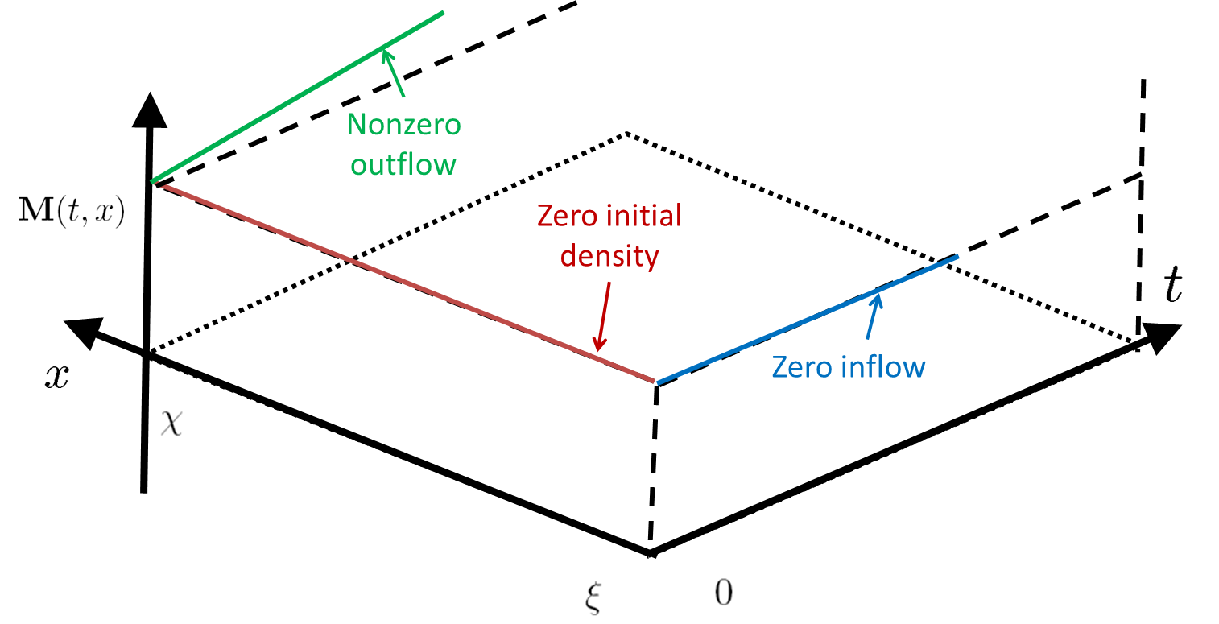
PDE model constraints
PDE model constraints are related to the concept of “weak boundary conditions”: the initial, boundary and internal conditions cannot be set arbitrarily
Examples:
[Claudel Bayen SIAM 2012] [Canepa Claudel IEEE ITSC 2012]

Slide 31
PDE model constraints
These constraints apply to any arbitrary number of initial/boundary/internal (and the like) conditions
Examples:
[Claudel Bayen SIAM 2012] [Canepa Claudel IEEE ITSC 2012]

Slide 32
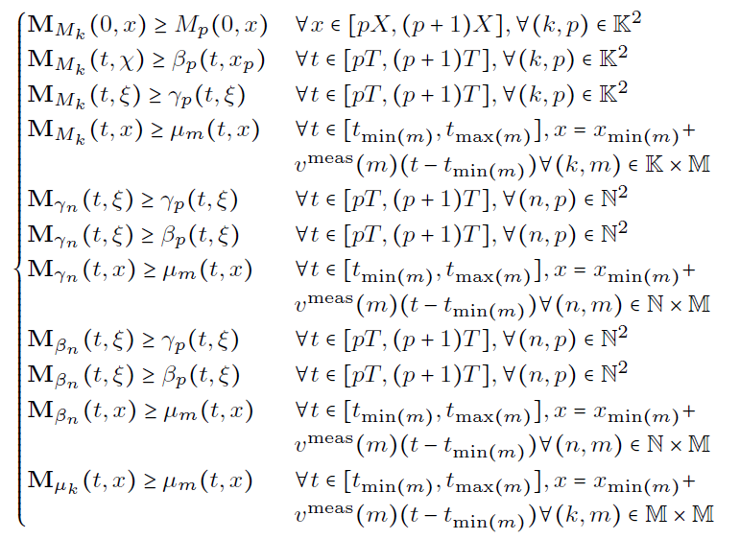
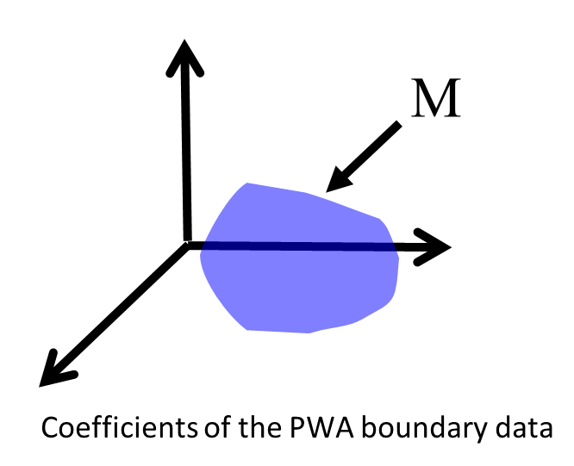
PDE model constraints
PDE model constraints in the present case are explicit and mixed integer linear
Explicit solution components (piecewise linear concave function of y)
Initial, boundary and internal condition data blocks (linear function of y)
Linear constraints
[Claudel Bayen SIAM 2012] [Canepa Claudel IEEE ITSC 2012]
Notes:
Plus grand
Pas la peine de comprendre les formulae
Le travail consiste a les calculer explicitement
La contribution: forme explicite avec dependence lineaire
Rajouter des poliedres

Slide 33
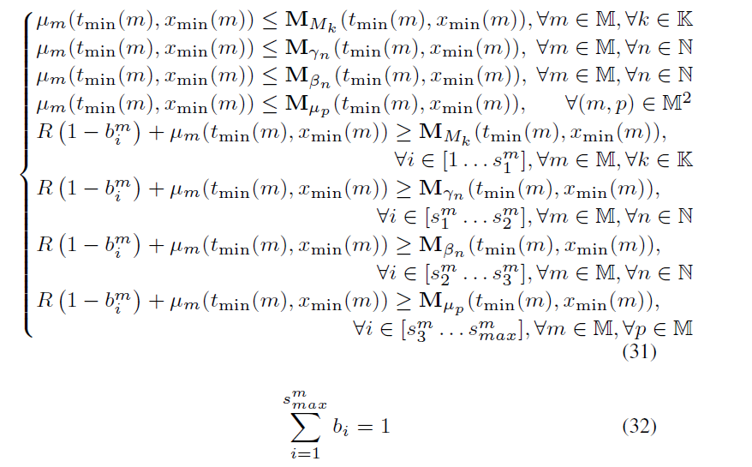
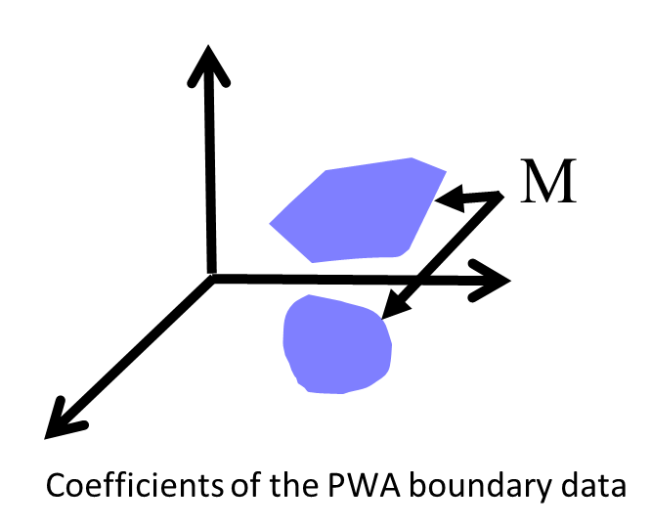
Continuity constraints
Additional constraints on y to ensure that the solution is continuous (remember, the solution to the HJ PDE is only lower semicontinuous in general)
Initial, boundary and internal condition data blocks (linear function of y)
Explicit solution components (piecewise linear concave function of y)
Integer linear constraints for continuity
Mixed integer-linear constraints
[Claudel Bayen SIAM 2012] [Canepa Claudel IEEE ITSC 2012]
Notes:
Rajouter des poliedres

Slide 34
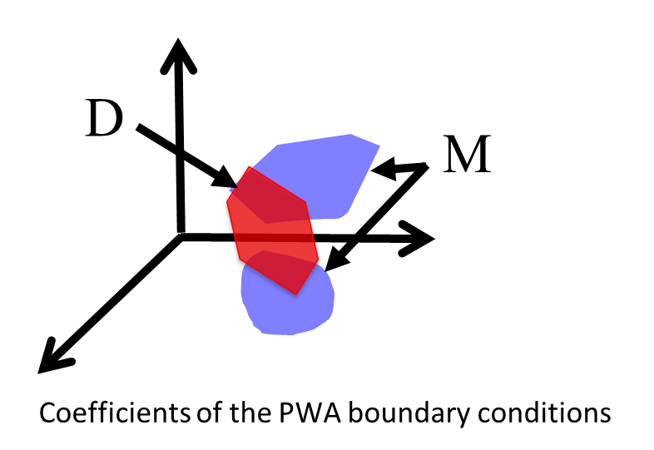
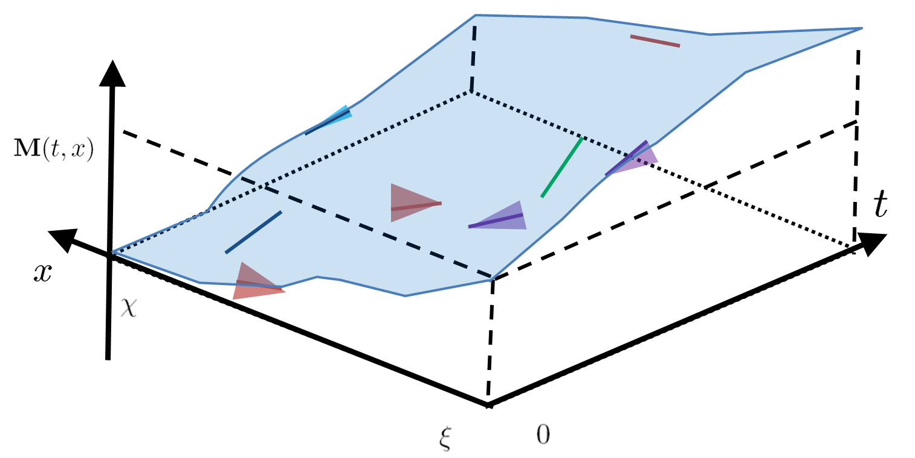
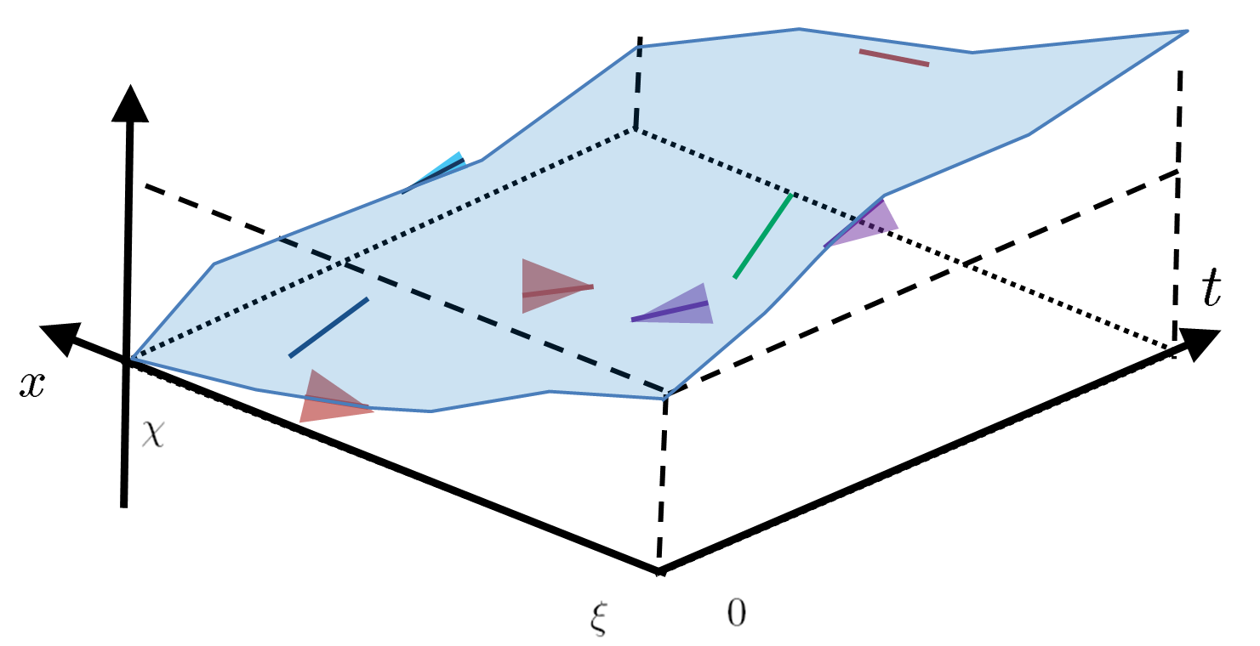
MILP formulation
Since the sensor data constraints are linear and the model data constraints are mixed integer linear, the feasible set of the problem is a union of polyhedra

Slide 35
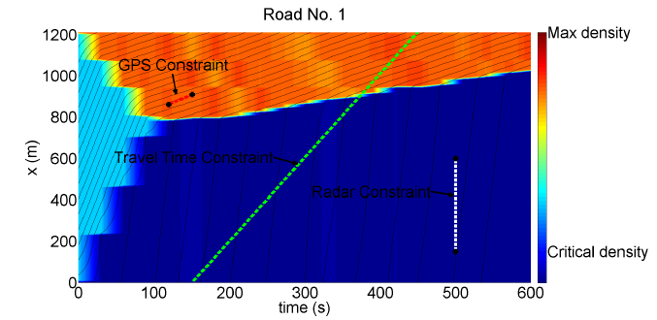
Estimation
Since we have non uniqueness in general, we select a given solution that minimizes an objective function (in addition to satisfying the model and sensor measurement constraints)
Example: minimum/maximum average density at the initial time, minimum L1 norm of changes in initial density profile, etc.
Notes:
Expliquer le space time diagram

Slide 36
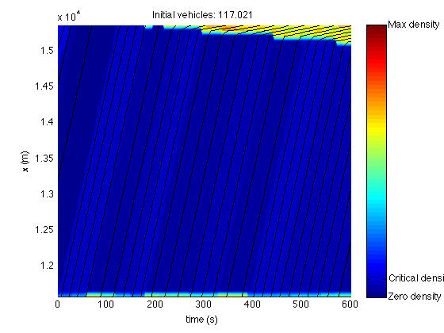
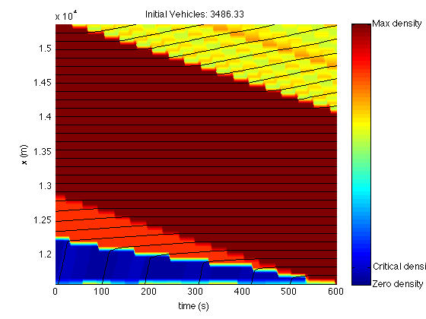
Convergence / monotonicity
Estimation of initial number of vehicles with multiple internal conditions
- No probe data
Min
Max
[Canepa, Claudel, ITSC 2012][Canepa, Claudel, NHM 2013][Canepa, Claudel, IEEE TAC (submitted)]
Notes:
20 Input flows from Mobile century experiment. Estimation of 6 initial conditions

Slide 37
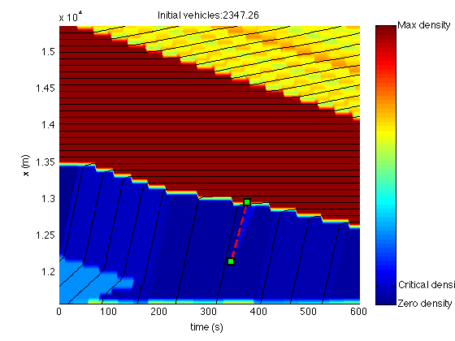
Convergence / monotonicity
Estimation of initial number of vehicles with multiple internal conditions
- 1 probe data
Min
Max
[Canepa, Claudel, ITSC 2012][Canepa, Claudel, NHM 2013][Canepa, Claudel, IEEE TAC (submitted)]
Notes:
20 Input flows from Mobile century experiment. Estimation of 6 initial conditions

Slide 38
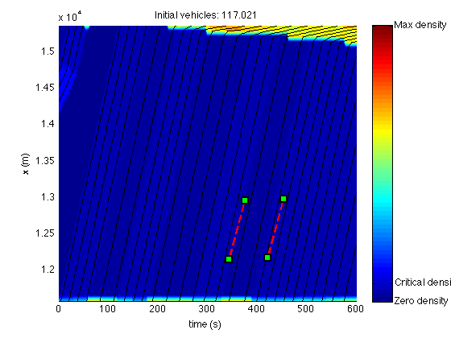
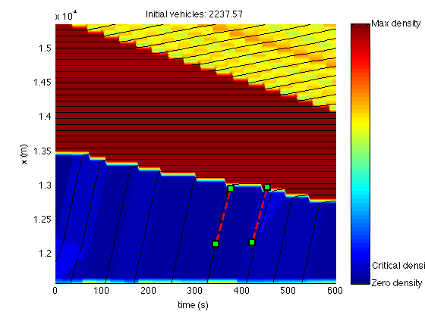
Convergence / monotonicity
Estimation of initial number of vehicles with multiple internal conditions
- 2 probe data
Min
Max
[Canepa, Claudel, ITSC 2012][Canepa, Claudel, NHM 2013][Canepa, Claudel, IEEE TAC (submitted)]
Notes:
20 Input flows from Mobile century experiment. Estimation of 6 initial conditions

Slide 39
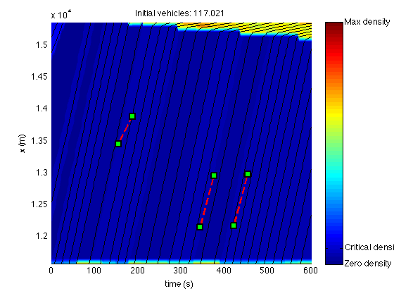
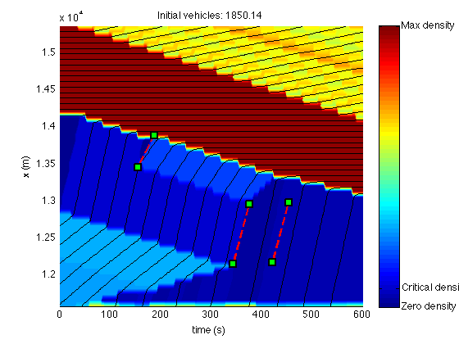
Convergence / monotonicity
Estimation of initial number of vehicles with multiple internal conditions
- 3 probe data
Min
Max
[Canepa, Claudel, ITSC 2012][Canepa, Claudel, NHM 2013][Canepa, Claudel, IEEE TAC (submitted)]
Notes:
20 Input flows from Mobile century experiment. Estimation of 6 initial conditions

Slide 40
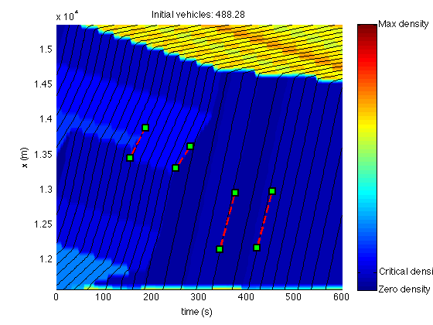
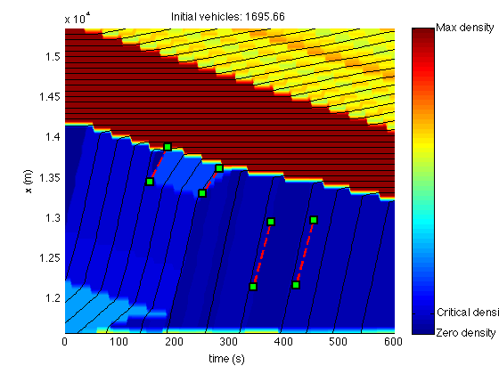
Convergence / monotonicity
Estimation of initial number of vehicles with multiple internal conditions
- 4 probe data
Min
Max
[Canepa, Claudel, ITSC 2012][Canepa, Claudel, NHM 2013][Canepa, Claudel, IEEE TAC (submitted)]
Notes:
20 Input flows from Mobile century experiment. Estimation of 6 initial conditions

Slide 41
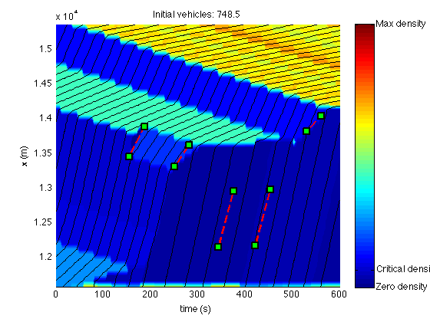
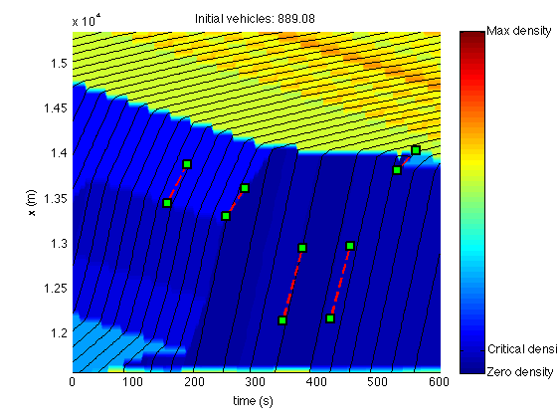
Convergence / monotonicity
Estimation of initial number of vehicles with multiple internal conditions
- 5 probe data
Min
Max
[Canepa, Claudel, ITSC 2012][Canepa, Claudel, NHM 2013][Canepa, Claudel, IEEE TAC (submitted)]
Notes:
20 Input flows from Mobile century experiment. Estimation of 6 initial conditions

Slide 42
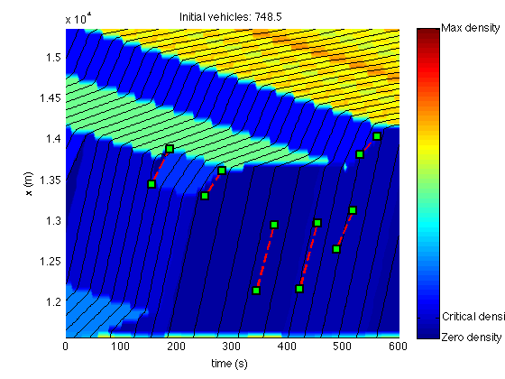
Convergence / monotonicity
Estimation of initial number of vehicles with multiple internal conditions
- 6 probe data
Min
Max
[Canepa, Claudel, ITSC 2012][Canepa, Claudel, NHM 2013][Canepa, Claudel, IEEE TAC (submitted)]
Notes:
20 Input flows from Mobile century experiment. Estimation of 6 initial conditions

Slide 43
Outline
Estimation problems involving Hamilton-Jacobi equations
- Background
- Problem definition
- Optimization formulations
Application to Networks
- Demand and supply formulation
- Junction models
- MILP formulation
Conclusion

Slide 44
Demand and supply
The upstream demand and downstream supply (used to compute the boundary conditions) can be defined in the HJ framework:
Bondary conditions
position
χ
Initial conditions
ξ
time
[Canepa, Claudel (in preparation)]
Notes:
Expliquer le space time diagram

Slide 45
Demand and supply
Demand between kT and (k+1)T: number of vehicles that would exit the domain with free boundary conditions after time kT
$D\left(kT,\left(k+1\right)T\right)=\frac{M\left(\left(k+1\right)T,χ\right)−M(kT,χ)}{T}$
Bondary conditions
position
χ
Initial conditions
ξ
time
[Canepa, Claudel (in preparation)]
Notes:
Expliquer le space time diagram

Slide 46
Demand and supply
Supply between kT and (k+1)T: number of vehicles that would exit the domain with free boundary conditions after time kT
S$\left(kT,\left(k+1\right)T\right)=\frac{M\left(\left(k+1\right)T,ξ\right)−M(kT,ξ)}{T}$
Bondary conditions
position
χ
Initial conditions
ξ
time
[Canepa, Claudel (in preparation)]
Notes:
Expliquer le space time diagram

Slide 47
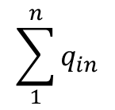
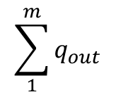
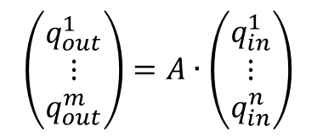
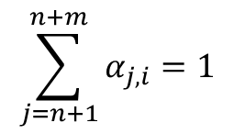
Junction models
Junction models relate actual flows to demand and supplies
Conservation of vehicle equation:
Priority rules
=
[Canepa, Claudel (in preparation)]
Notes:
Expliquer le space time diagram

Slide 48
Junction models
The priority and conservation of vehicles alone are not sufficient to pinpoint a single solution
Max flow constraint: at least one of the inflows/outflows is equal to the corresponding demand/supply
This maximizes the throughput of the intersection
Requires Boolean variables to identify which inflow/outflow is equal to the corresponding demand/supply
[Canepa, Claudel (in preparation)]
Notes:
Expliquer le space time diagram

Slide 49
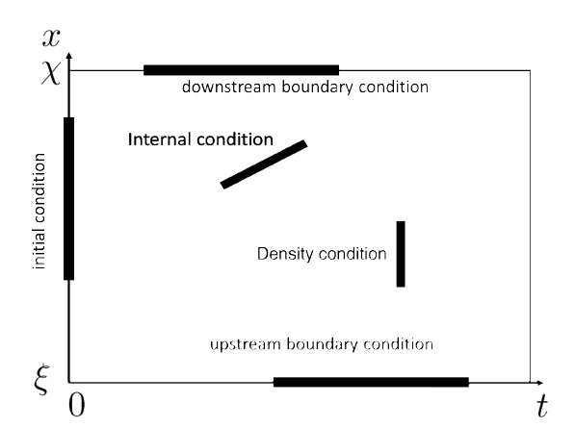
MILP formulation
On each link, the model and data constraints are mixed integer linear:
Flow and travel time constraints at the edge of the domain are linear
Internal velocity, flow and density measurement constraints are mixed integer linear
Junction constraints are mixed integer linear
[Canepa, Claudel (in preparation)]
Notes:
Expliquer le space time diagram

Slide 50
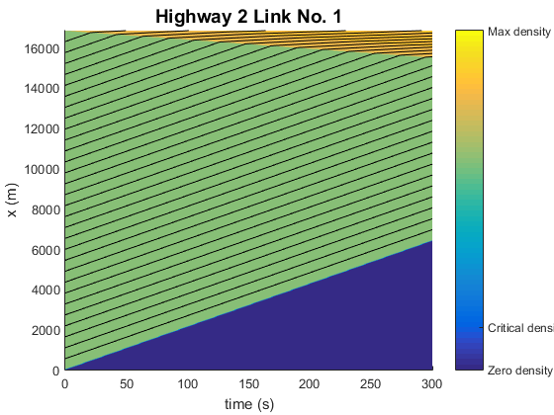
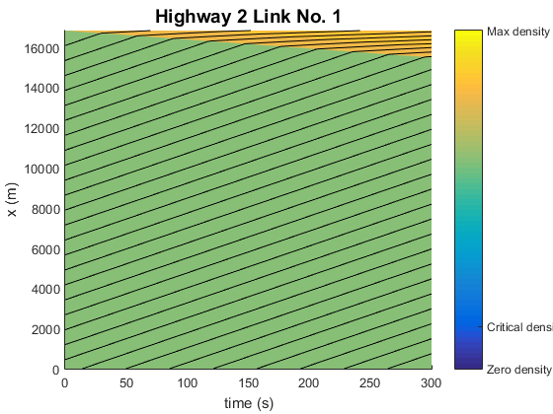
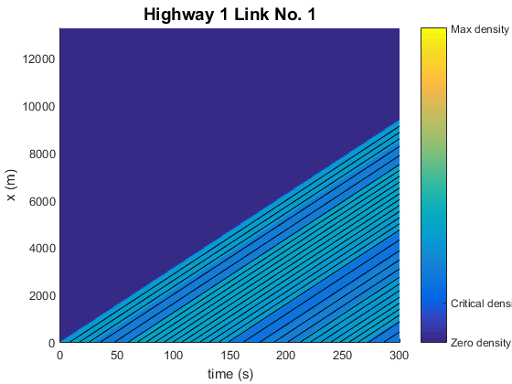
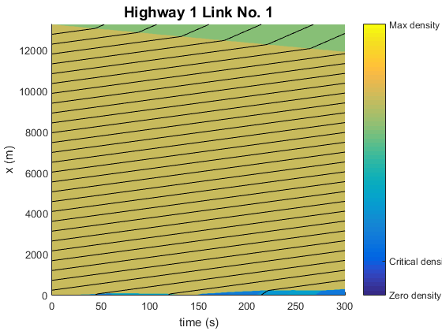
MILP formulation
Application (I): estimation of traffic on an actual road network:
[Canepa, Claudel, TR-B 2016 (submitted)]
Notes:
Expliquer le space time diagram

Slide 51
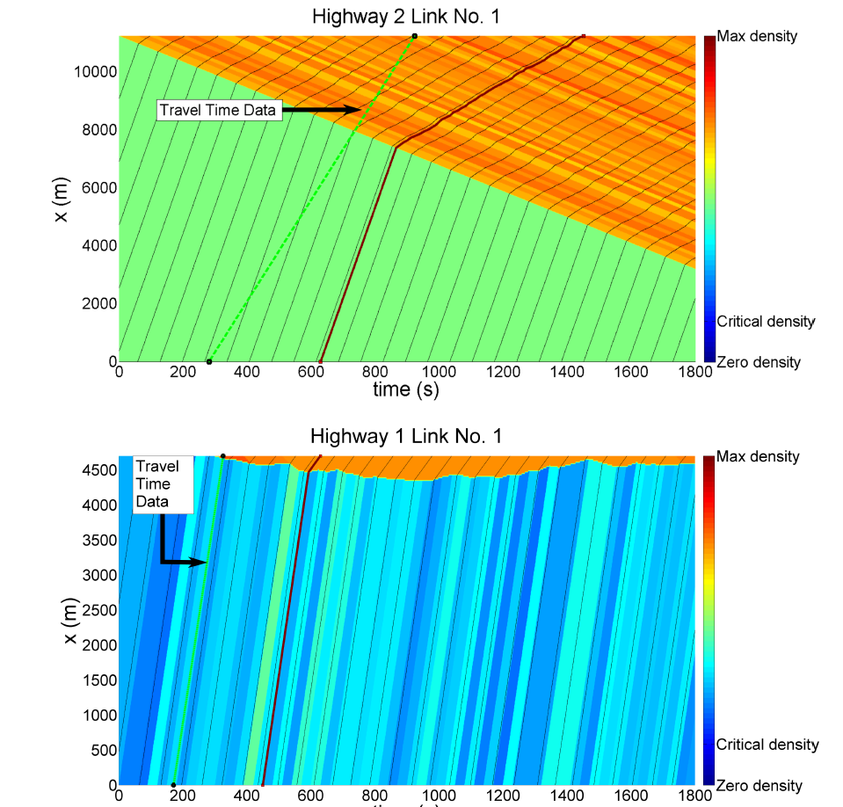
MILP formulation
Application (II) : compressed sensing approach to network state estimation (L1 norm minimization)
[Canepa, Claudel, TR-B 2016 (submitted)]
Notes:
Expliquer le space time diagram

Slide 52
Outline
Estimation problems involving Hamilton-Jacobi equations
- Background
- Problem definition
- Optimization formulations
Application to Networks
- Demand and supply formulation
- Junction models
- MILP formulation
Conclusion

Slide 53
Conclusion
Conclusion
Estimation framework can integrate any type of data (density, flow, travel time, mobile sensor data…)
Less Boolean variables than frameworks based on the discretization of the LWR PDE (1 per junction, vs 1 per cell),
particularly useful when considering systems of long links
Limitation:
- no model noise

Slide 54
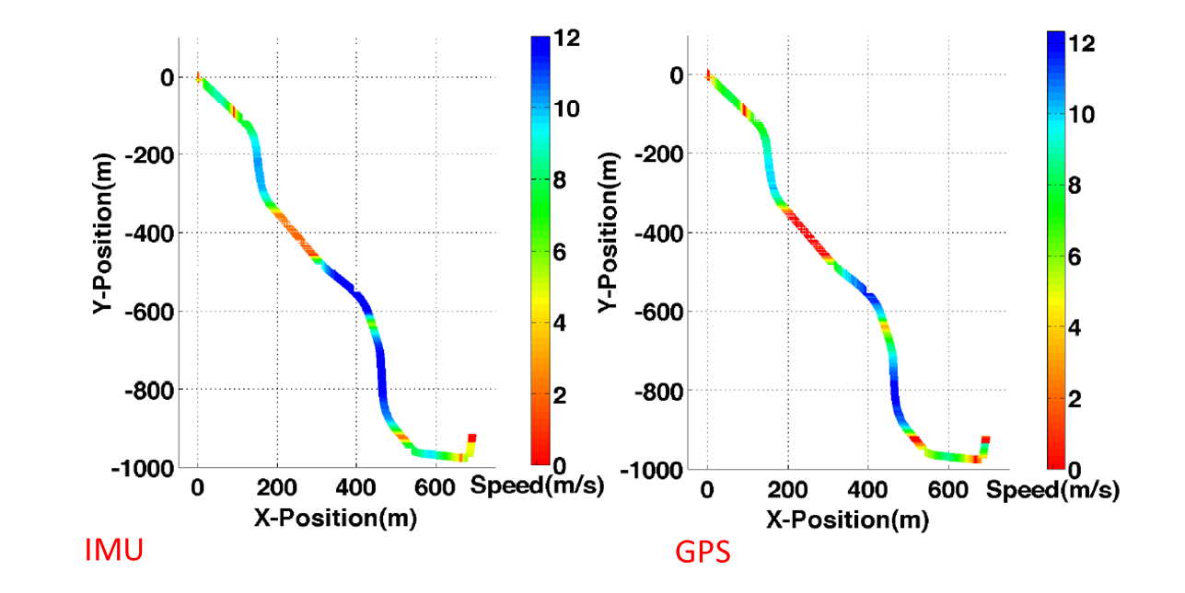
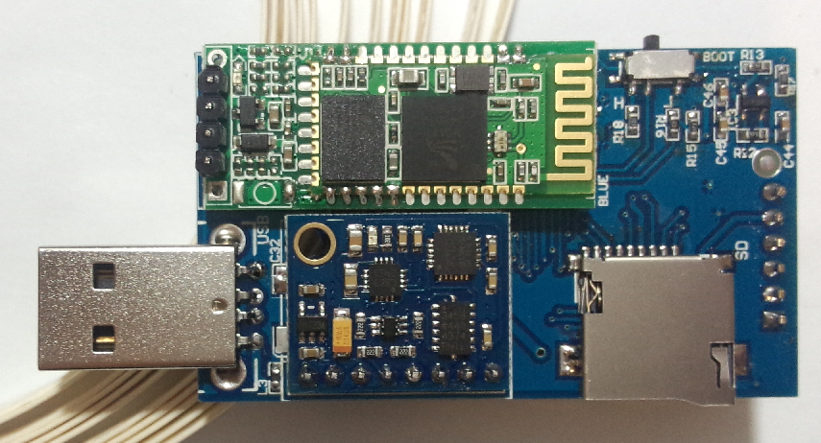
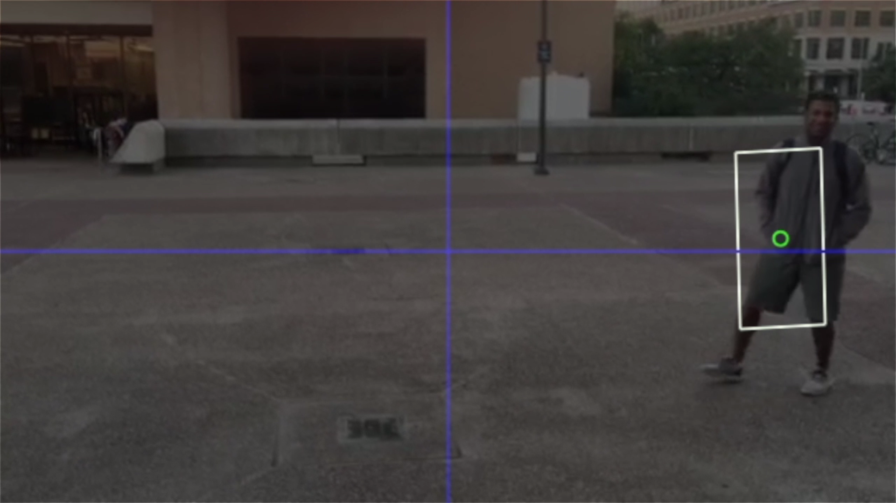
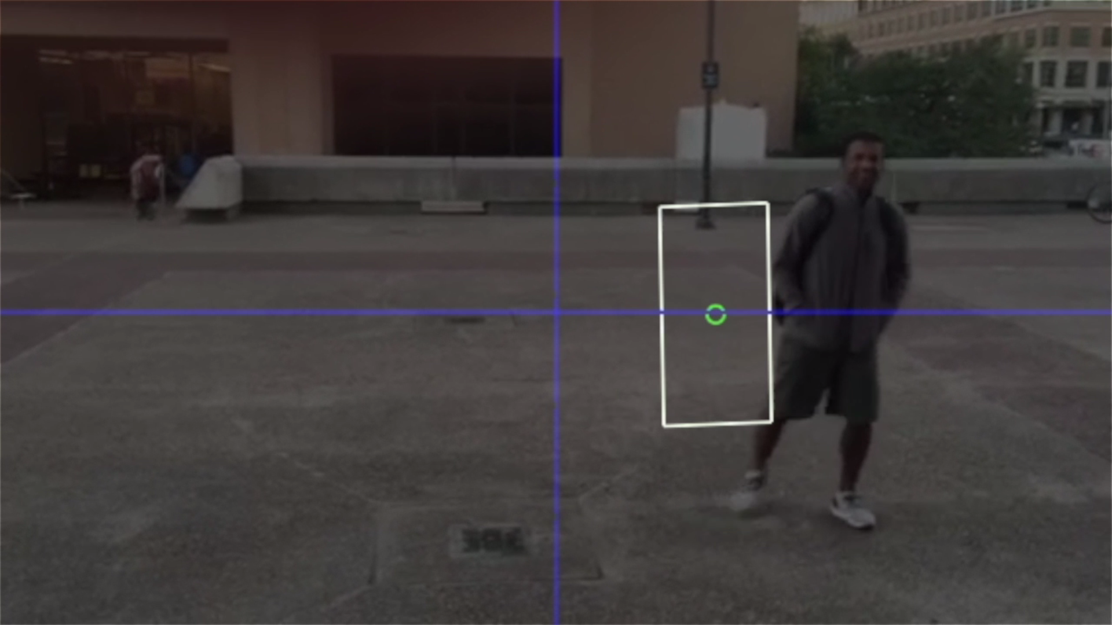
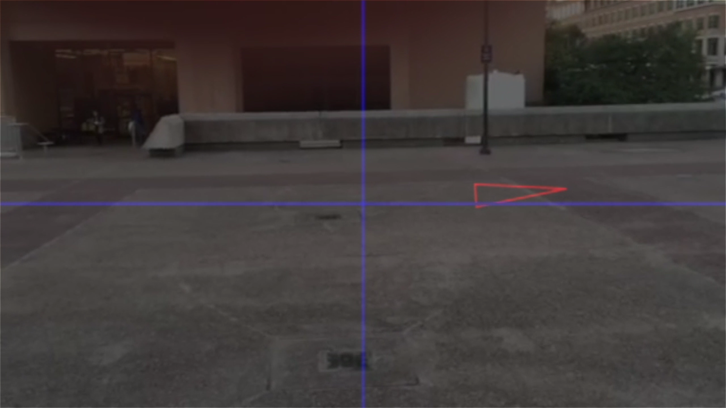
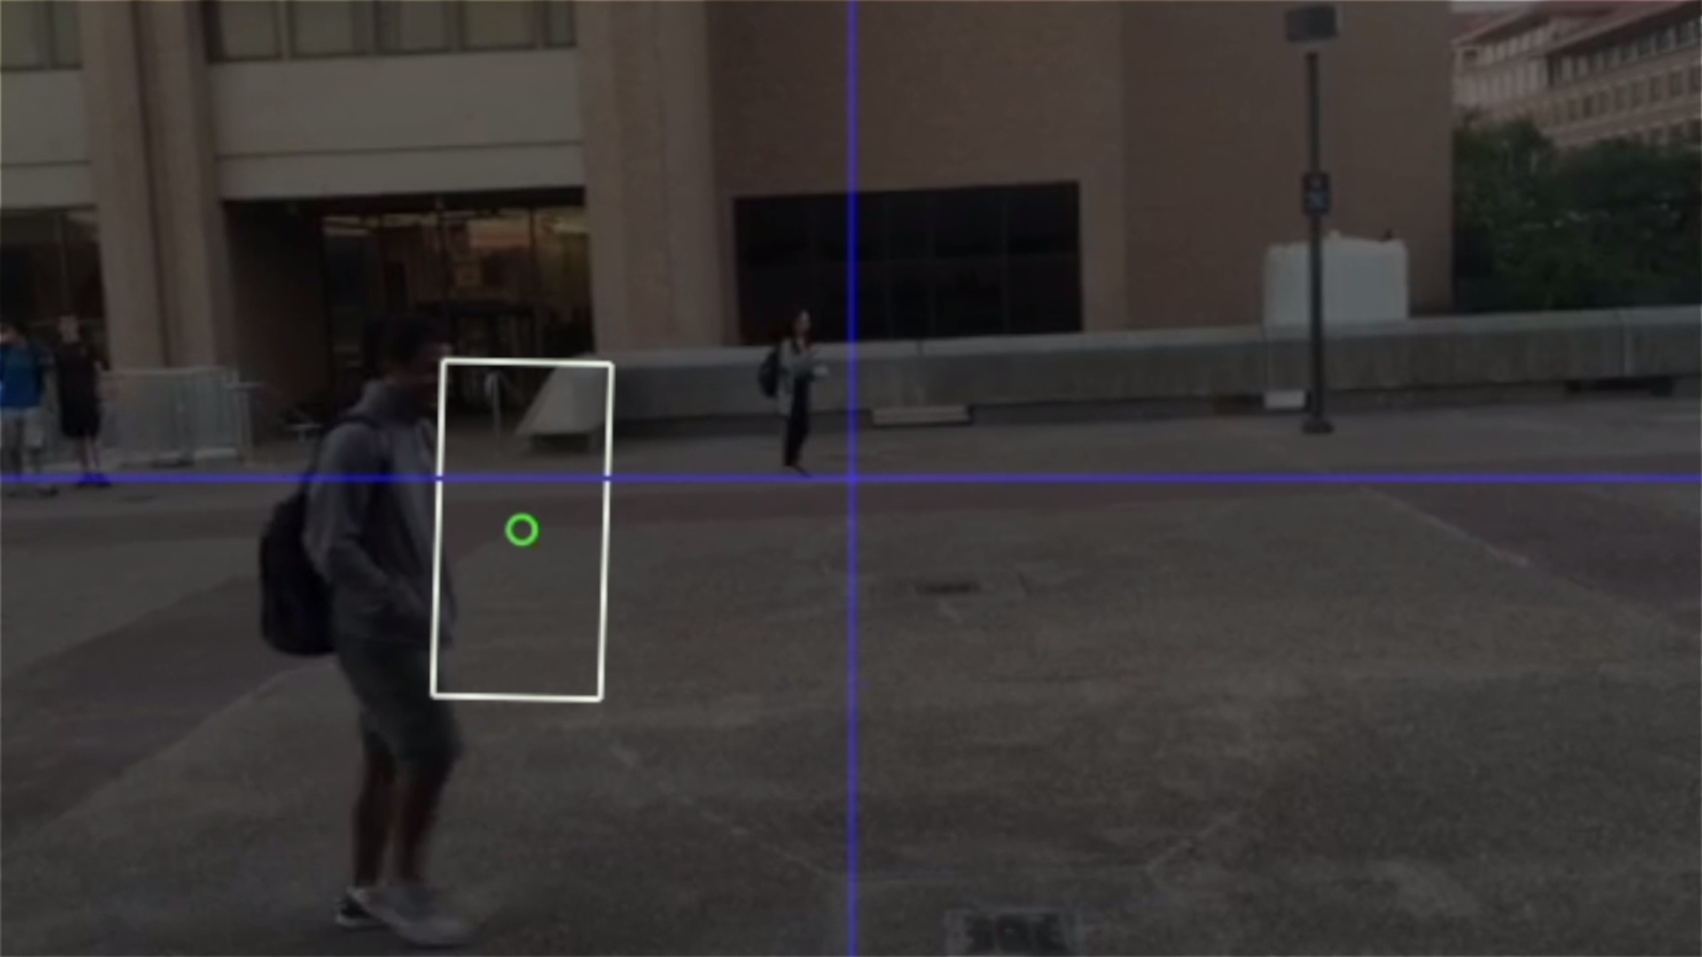
Conclusion
Other activities (transportation)
Inertial measurement unit-based traffic flow monitoring
Wearables and augmented reality for traffic safety

